Slide 1
Notes:
Change background image by right-clicking the image > Format Background > Picture source > Insert

Slide 2
Example – Creating Opportunity
Presenter Name
Harvard University
PRESENTATION NAME | DATE

Slide 4
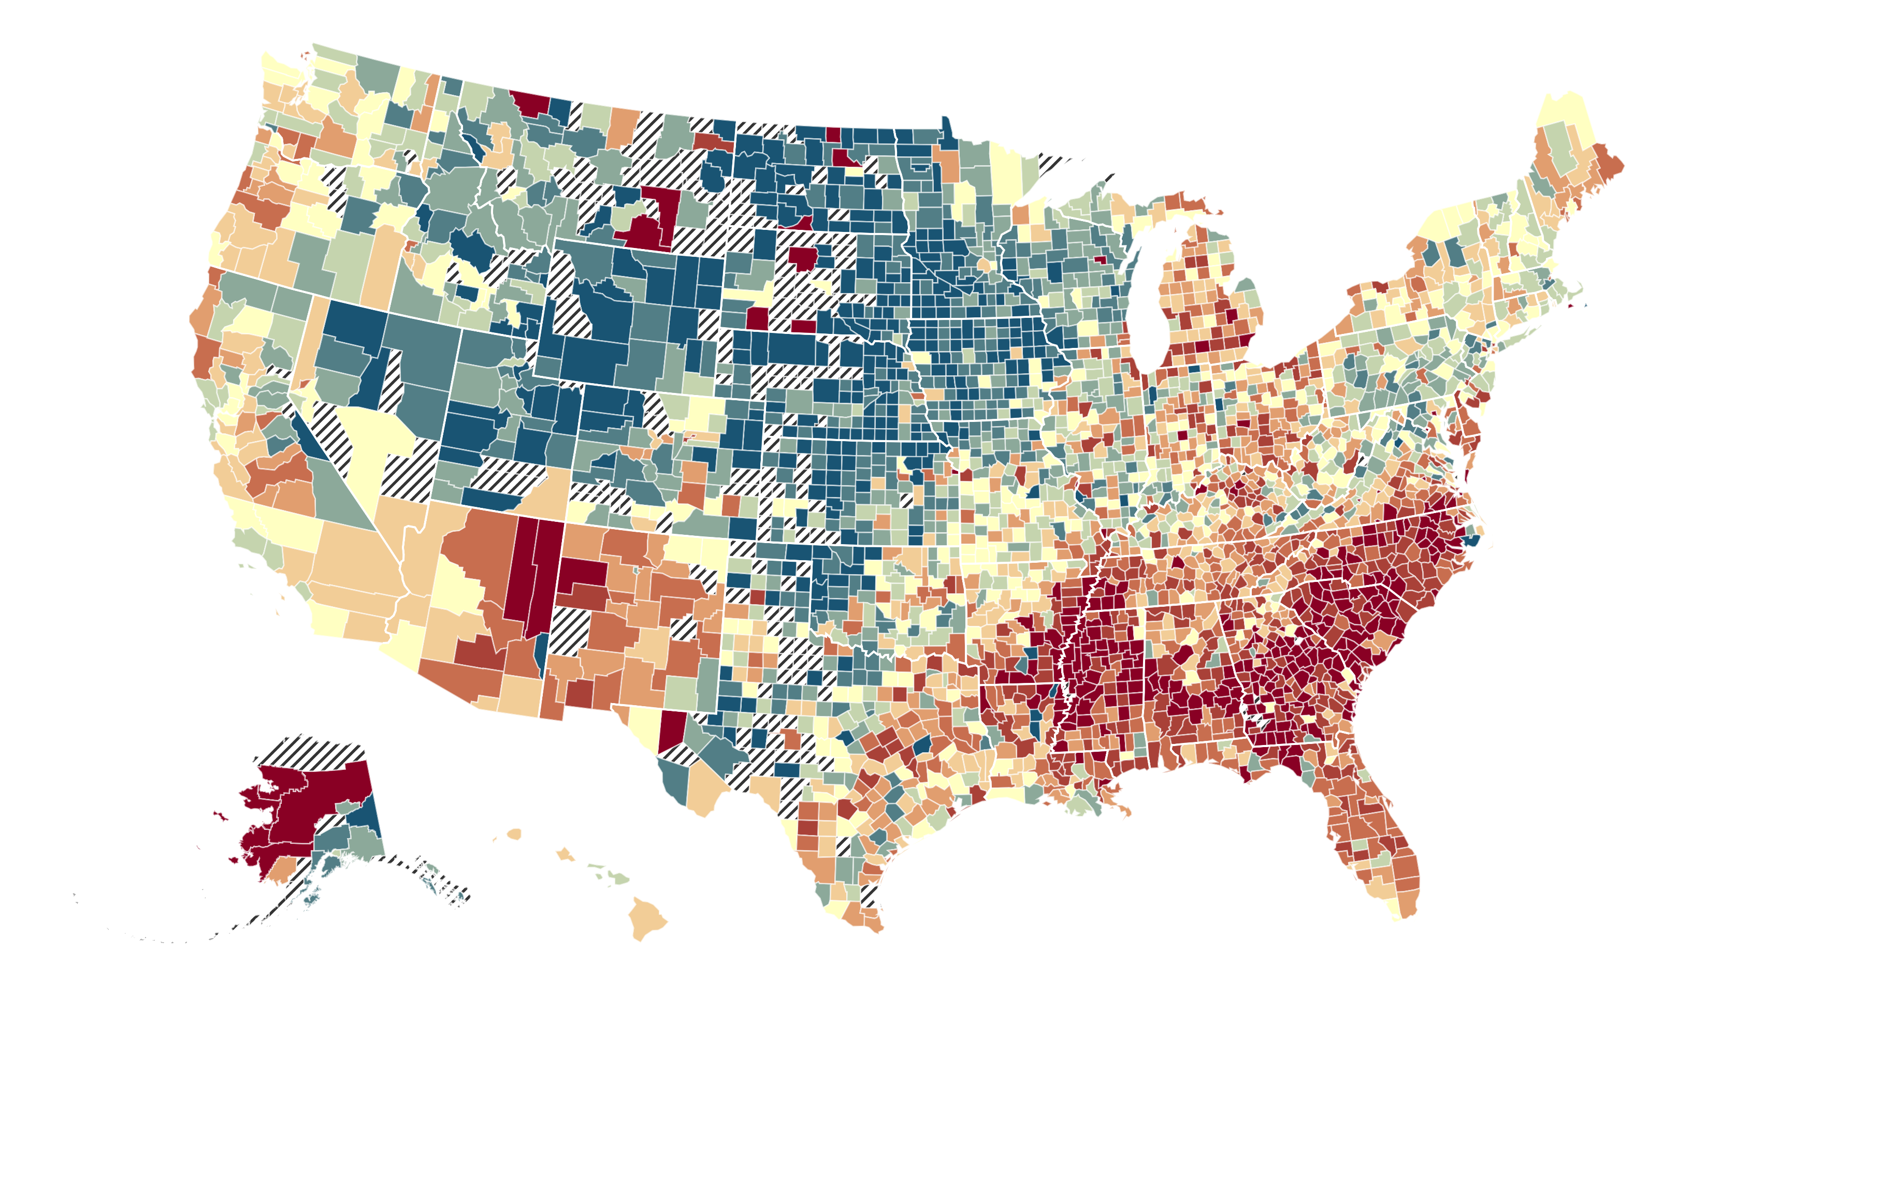

Example - The Geography of Upward Mobility in the United States
Average Household Income at Age 35 for Children Born in 1978 whose Parents Earned $27K (25th percentile)
Dubuque
$45.5K
Columbus
$28K
Pittsburgh
$36K
Portland
$33K
Bridgeport
$33K
Las Vegas
$30K
Philadelphia
$31K
Baltimore
$28K
Winston-Salem
$27K
Charlotte
$26K
Baton Rouge
$30K
<$20k
$33k
>$55k
Austin
$31K
Blue = More Upward Mobility
Red = Less Upward Mobility
Source: Chetty, Hendren, Kline, Saez (QJE 2014)

Slide 6





Example - Creating Moves to Opportunity Experiment
Seattle and King County, WA
Randomized trial to test strategies to reduce barriers that voucher recipients face in moving to high-opportunity areas:
Customized counseling
Connections to landlords
Short-term financial assistance

Slide 8
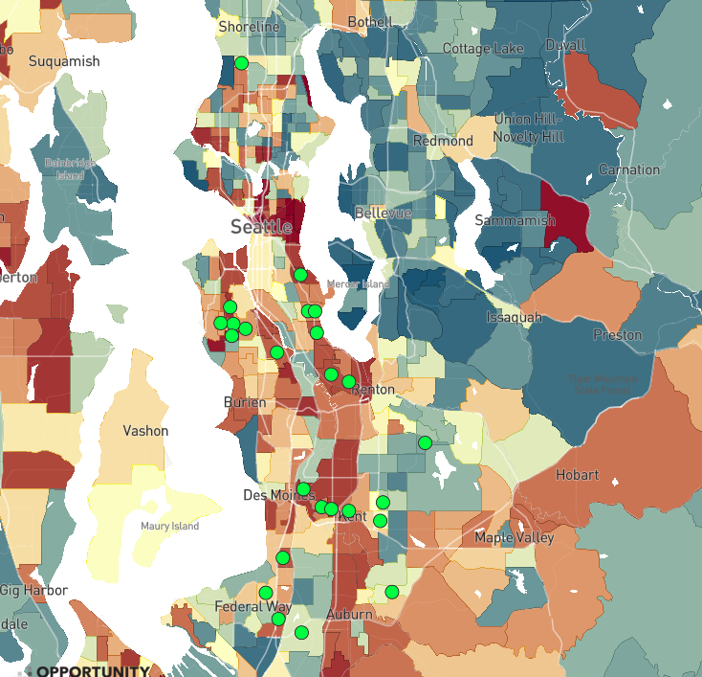

Example - Where Housing Choice Voucher Holders Live in Seattle
25 most common tracts where voucher holders lived in 2015-17
Percentile Rank in Adulthood
> 60 ($55k)
48 ($39k)
< 30 ($20k)
Source: Chetty, Friedman, Hendren, Jones, Porter (2018)

Slide 10
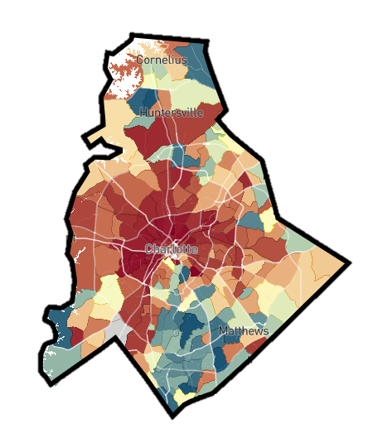


Example - Three Policy Approaches to Increasing Upward Mobility
Reducing
Segregation
Place-Based
Investments
Higher Education & Workforce Training
Help Low-Income
Families Move to
High-Opportunity Areas
Increase Upward Mobility in Low-Opportunity Areas
Amplify Impacts of Colleges and Training Programs on Mobility

